Slide 1
Football & Education Study Programme
QUALITAS POST 16

Slide 2
Qualitas Sport Academy
The Qualitas BTEC Level 3 Extended Diploma in Sport (Football Education Programme) is a two-year course suitable for post-16 male students of all playing abilities who have a keen interest in developing an insight into the sport industry.
Based at Graves Leisure students will study in purpose-built classrooms and facilities, creating a perfect learning environment to thrive within.
Alongside the academic studies, where 15 sports related units will be covered, students will train and play on a weekly basis, representing Qualitas in the Regional College League & against Academy professional clubs in friendly fixtures, aiding the courses uniqueness.
Qualitas are passionate about enhancing students’ employability skills, which is why students have access to work experience within Qualitas. These opportunities include leadership at over 50 sporting events across 20 different sports, ranging from football and netball to water polo and fencing. Other avenues available to all learners is coaching qualifications (level 1/2) and ultimately paid work in the PE and sporting industry with Qualitas.

Slide 3
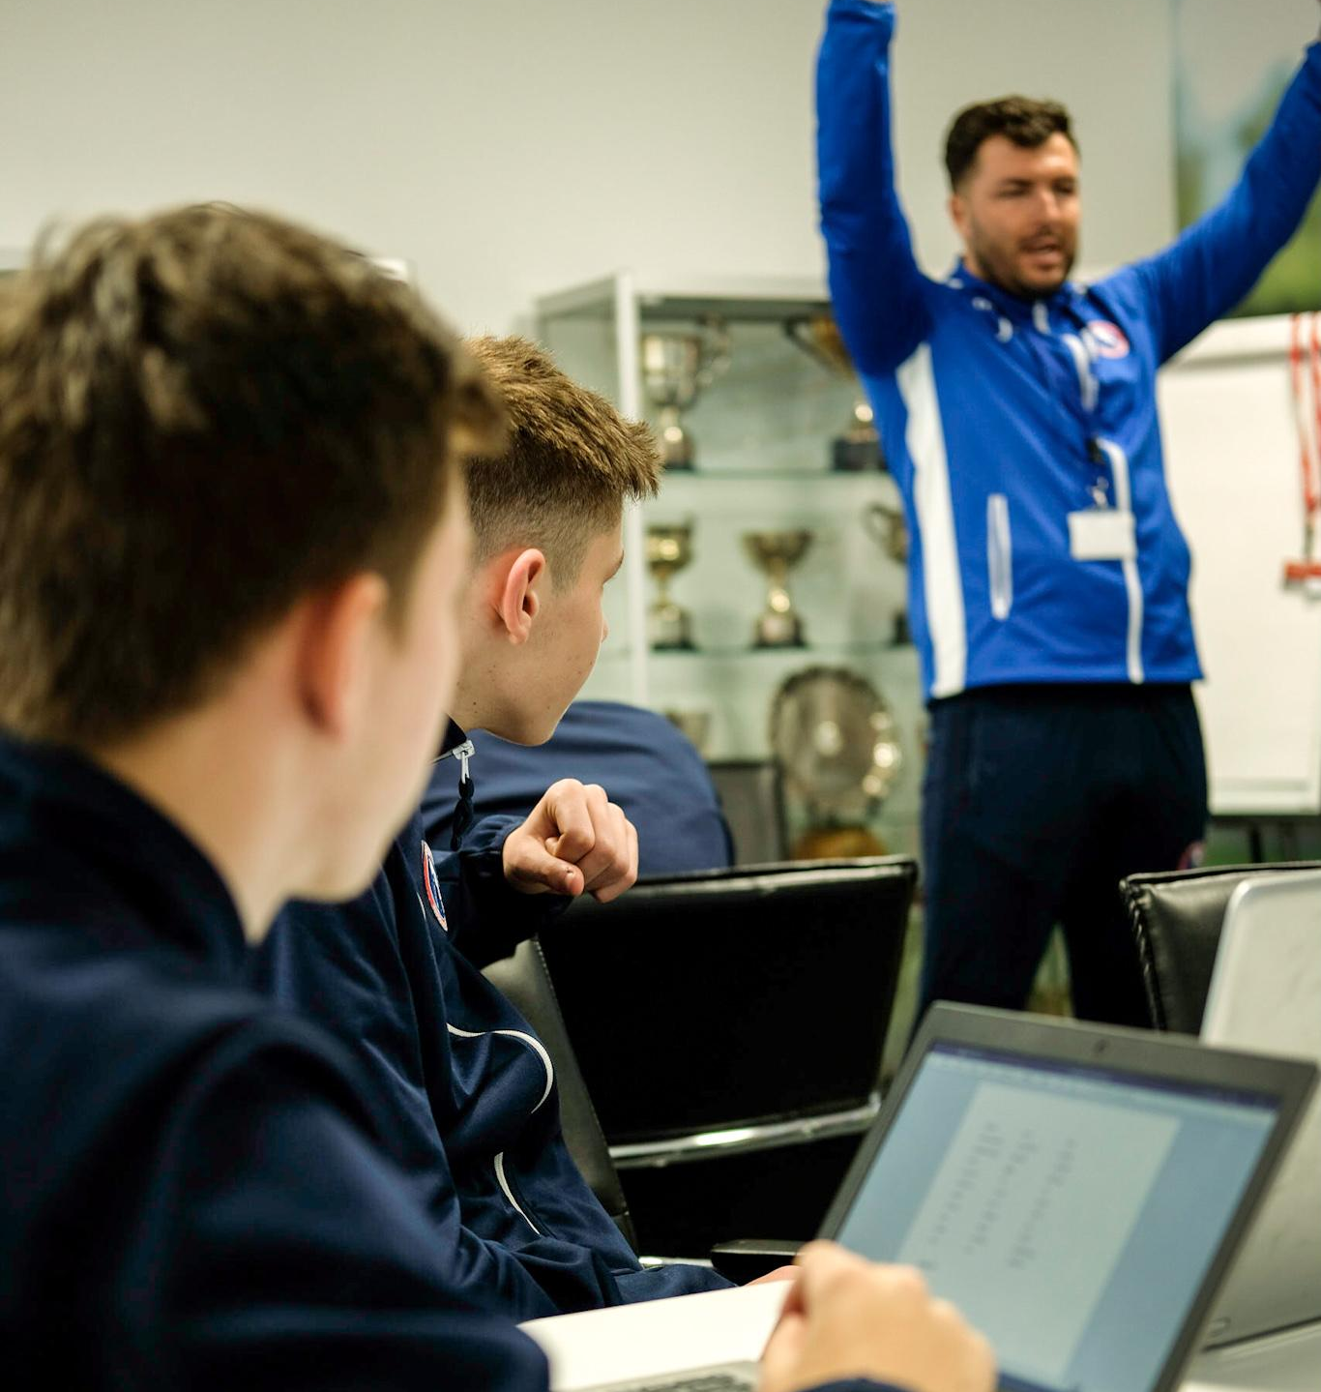
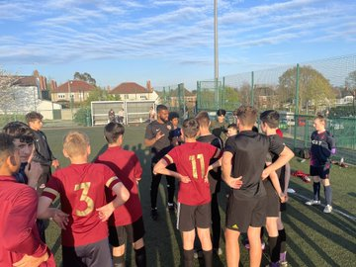
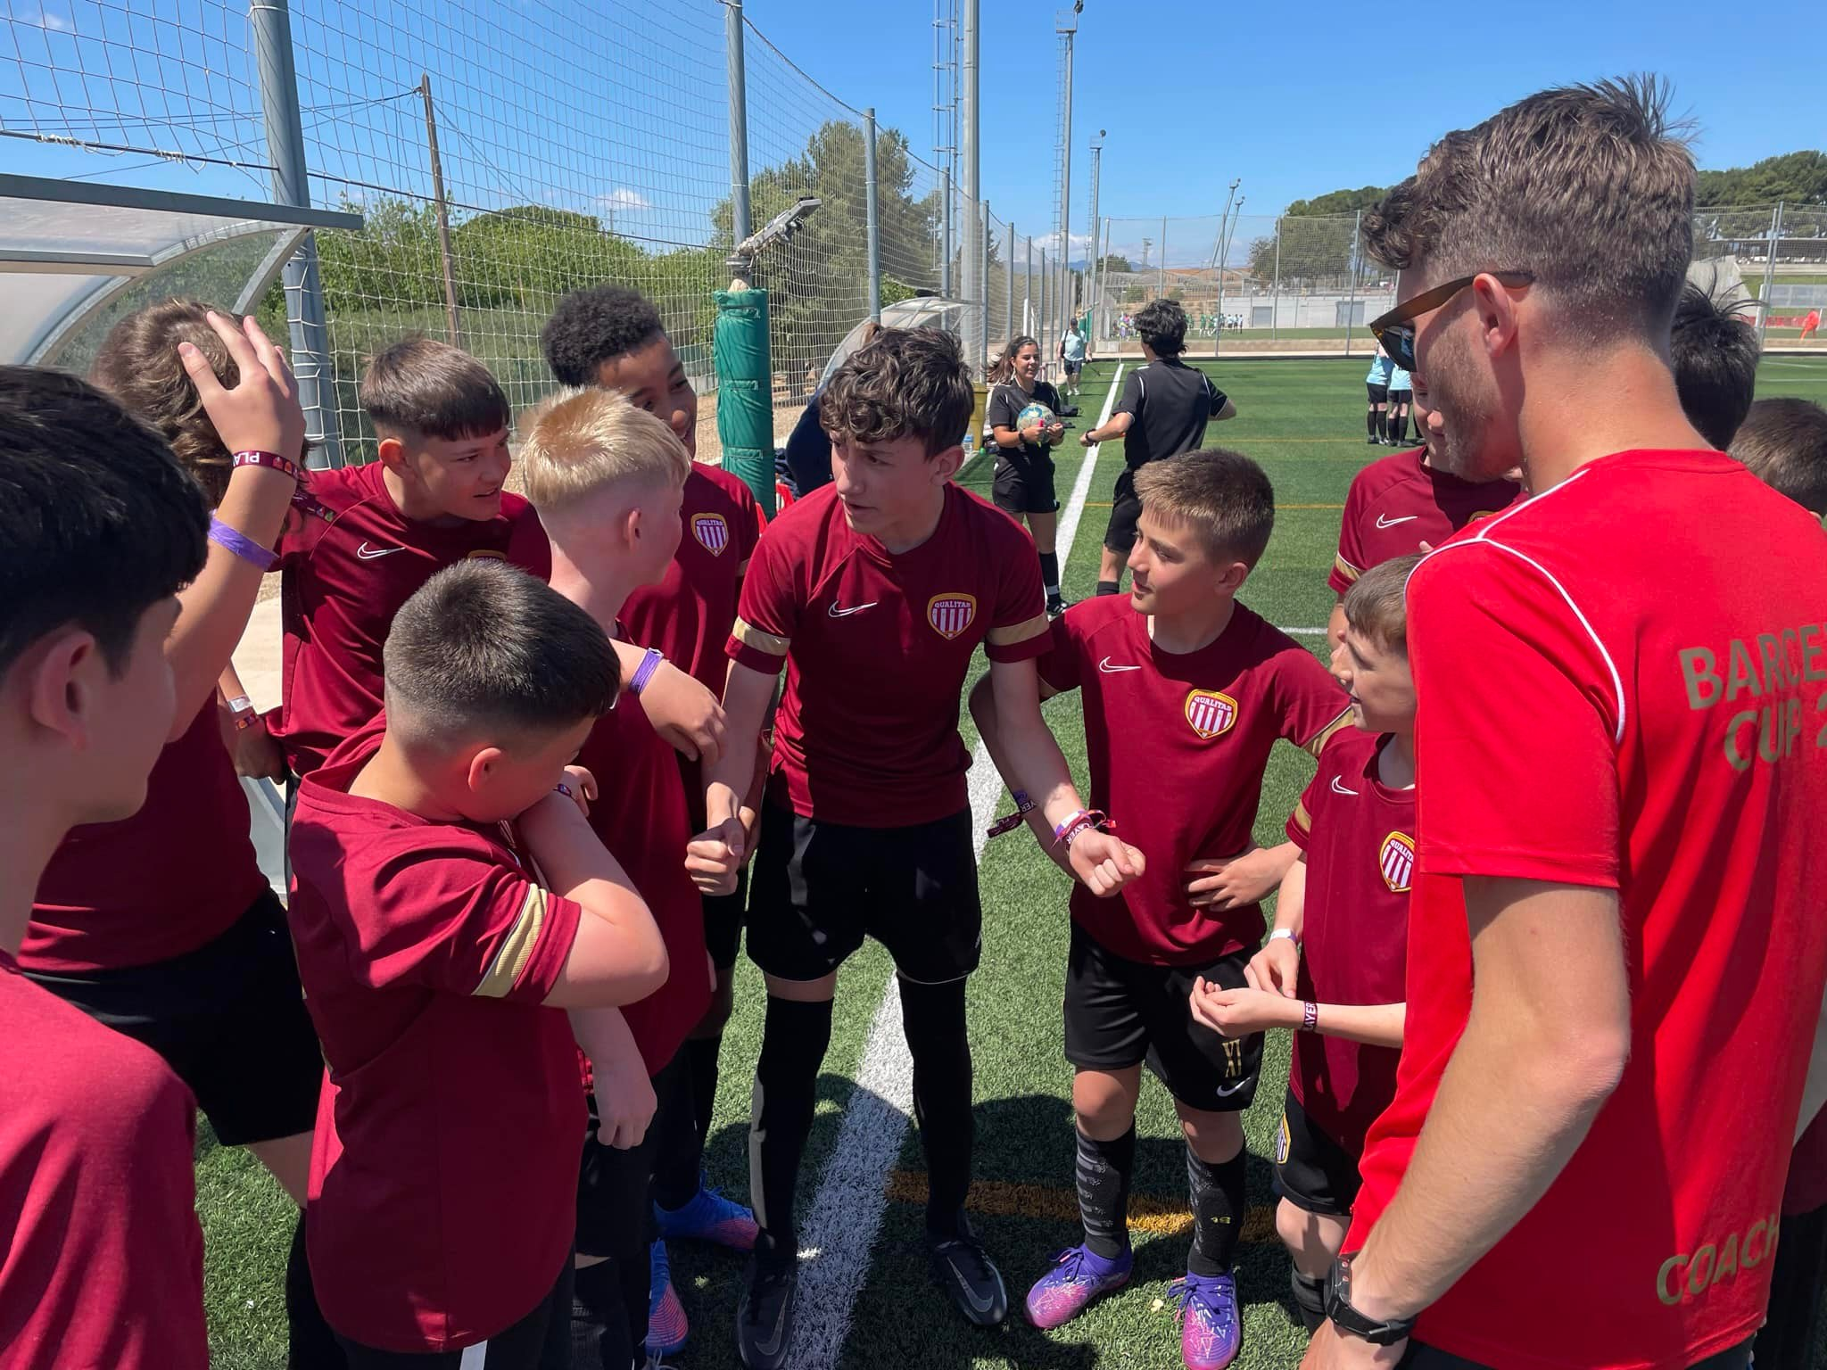
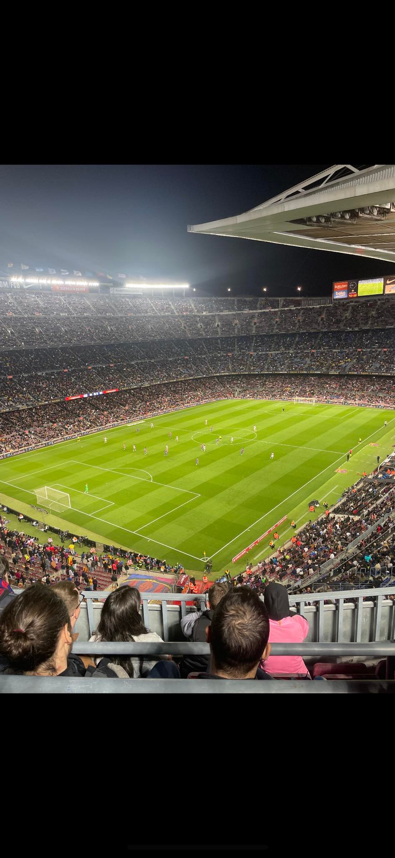
Study Programme Overview
Study & Train on vocational Courses
Enrichment and extra curricular activities
Virtual e-learning platform
Competitive Sports Fixtures
Professional club/industry experience

Slide 4
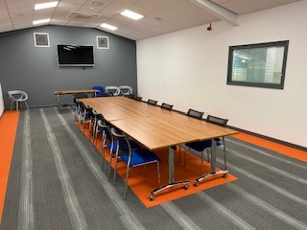
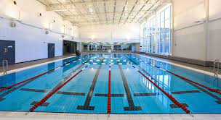
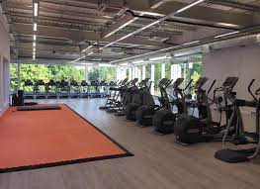
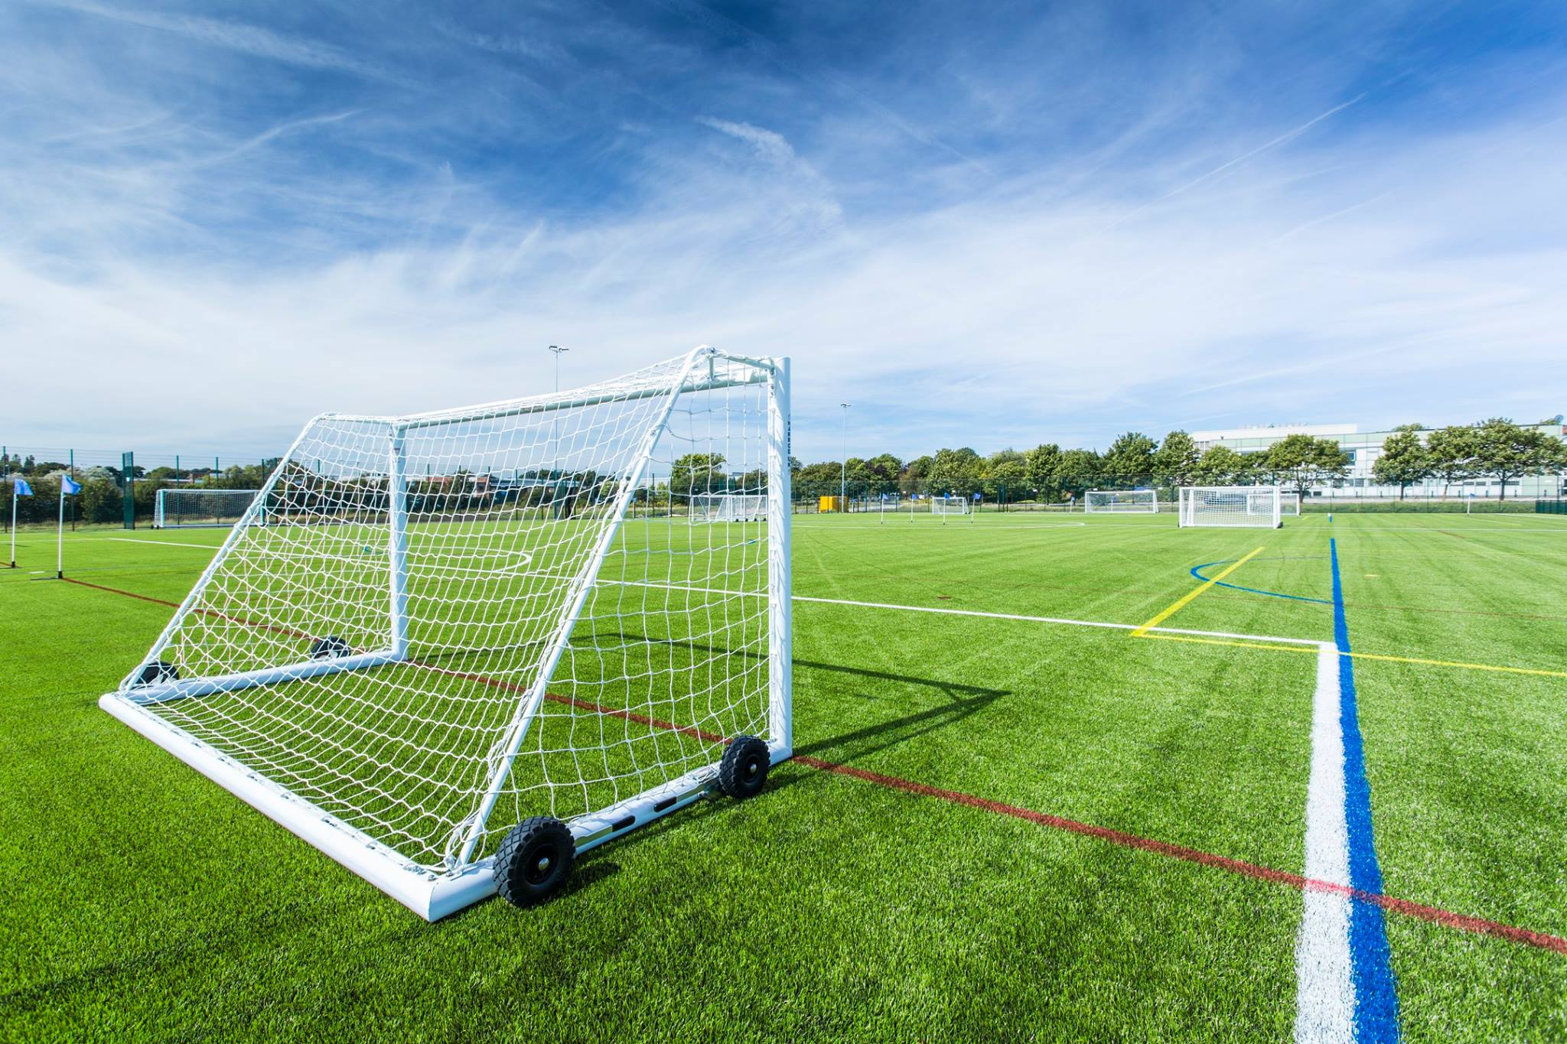
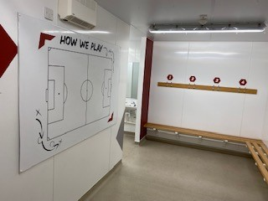
The Campus – Qualitas Sports Academy

Slide 5
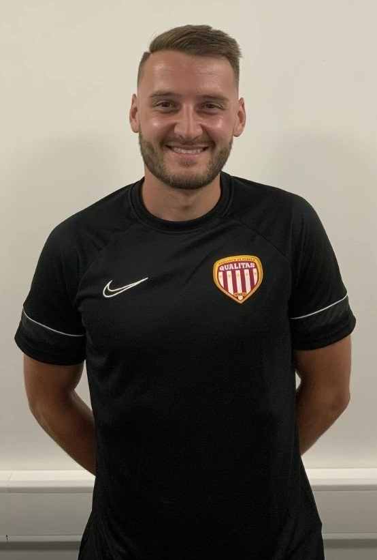
The Team – Luke Ancell – Education and Enrichment tutor
Studied BTEC level 3
Played academy football at SUFC 14-16
Sheffield Hallam University
Worked in fitness/leisure
Worked in PE/sport for 11 years

Slide 6
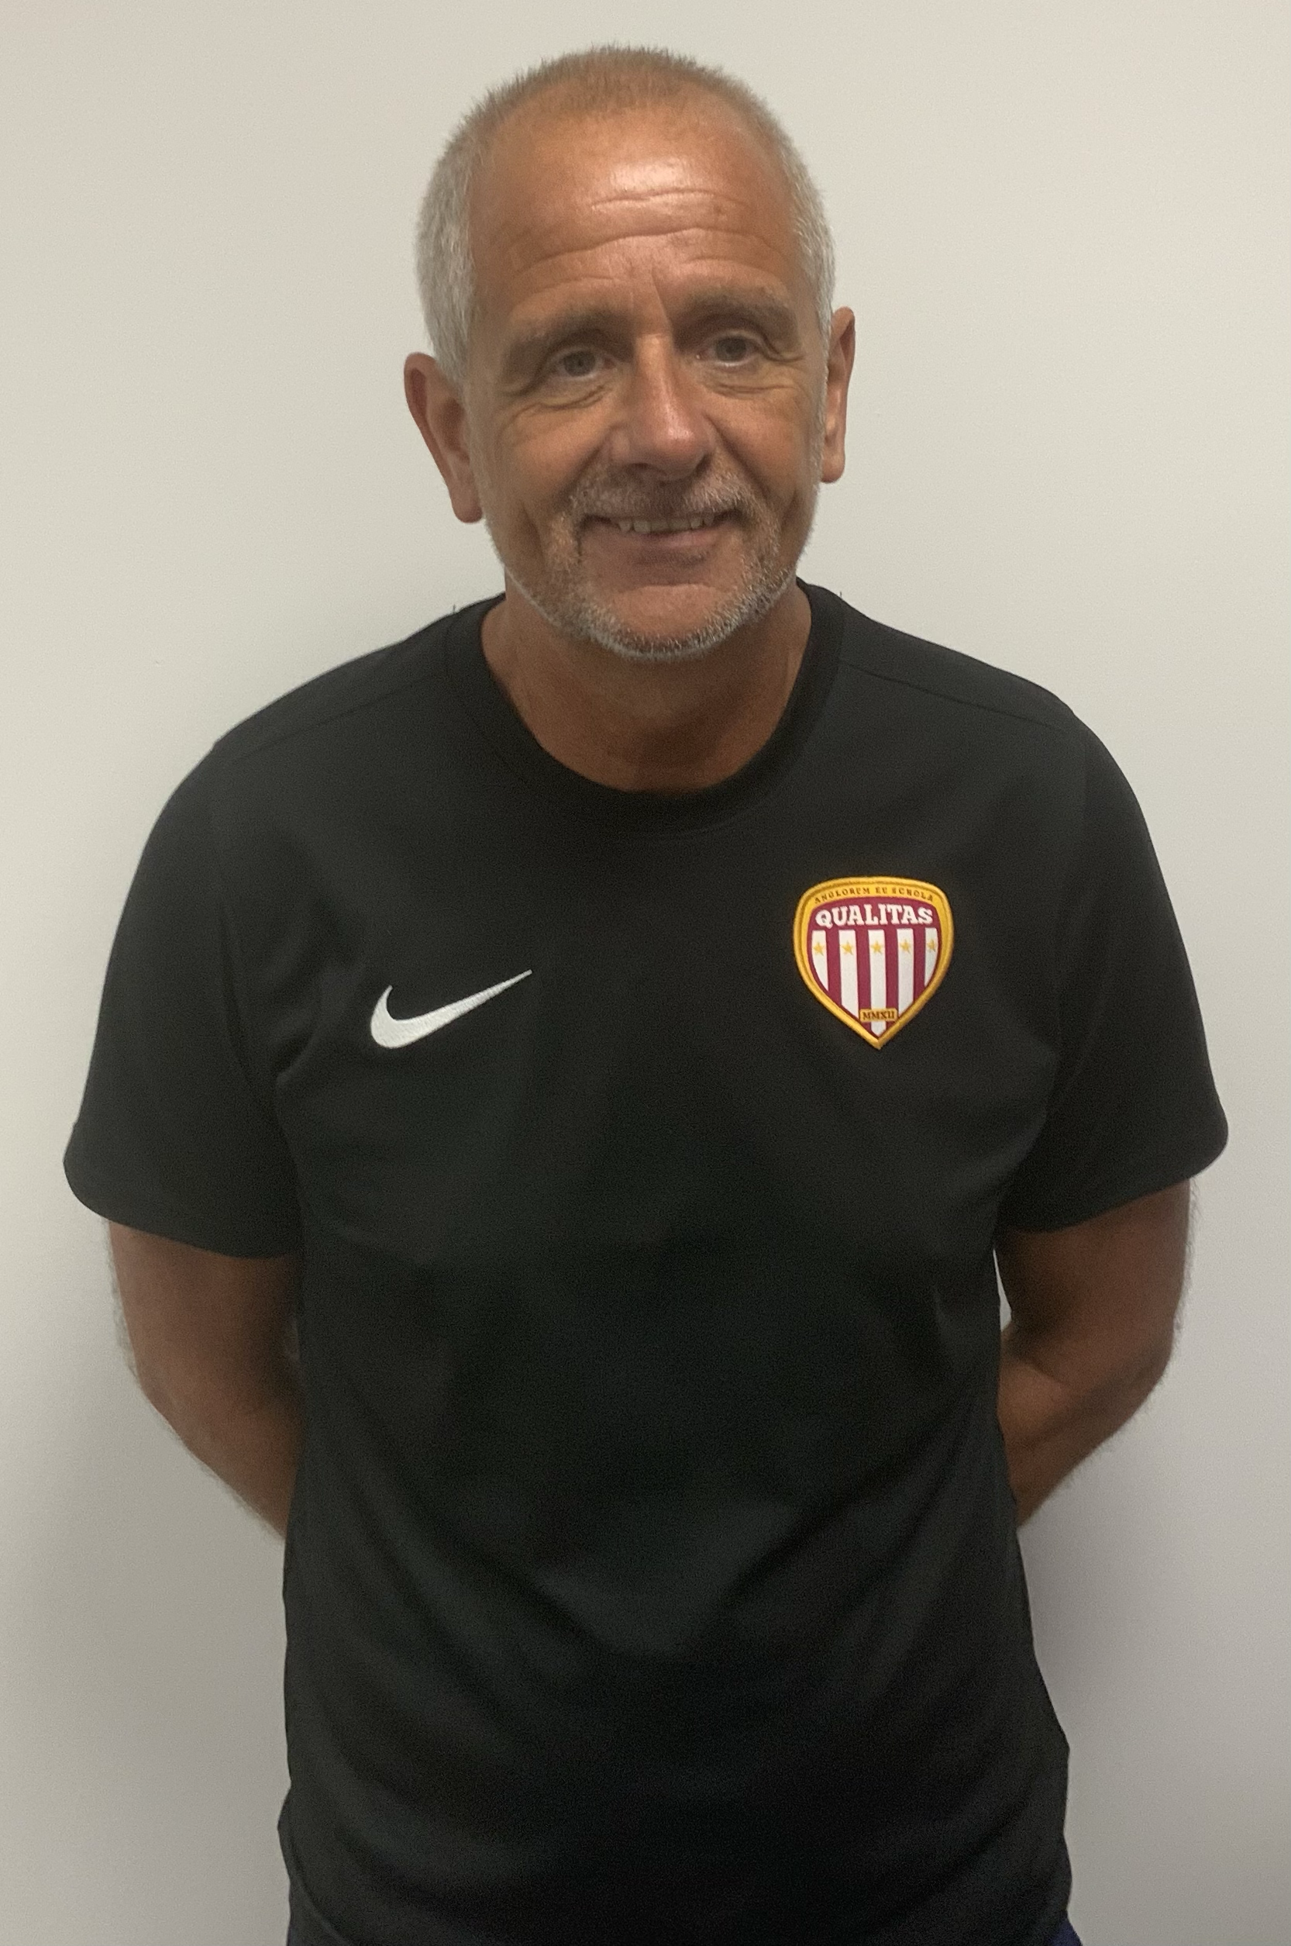
The Team – John Knapper – Post 16 Scholarship Manager
35 years of Football experience.
Played at Elite level
Extensive Coaching Philosophy
Premier League/EFL experience
Professional contacts across all levels

Slide 7
Study Programme Opportunity
Level 3 BTEC Extended Diploma
Full time 2 year course
Worth up to 3 A Levels
Optional Sports Coaching & refereeing/Umpiring Certificates
Work Experience
English & Maths
Pathways
Higher Education/University
Career in diverse areas of sport
Playing Opportunities

Slide 8
Level 3 BTEC Sports Coaching & Development
Worth up to 3 A Levels
For those intending to follow a career as a sports coach or to work in a sports performance organisation
No Exams - Internal & Synoptic Assessment
Allows access to University
Units Include
Psychology for Sports Performance
Professional Sports Performer
Health, Wellbeing & Sport
Applied Anatomy & Physiology
Nutrition for Sports Performance
Entry Requirements
4 GCSE’s (9-4), including English & Maths
English & Maths Lessons and exams are compulsory for those students allowed onto the programme with grades 3 and below.

Slide 9
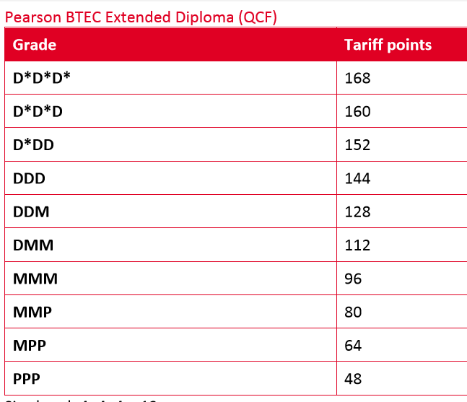
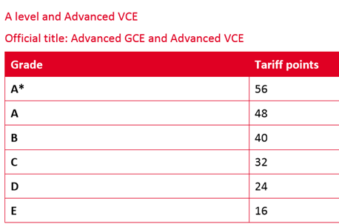
BTEC Credibility
Tariff Points
BTEC is recognised by Major UK and International Universities

Slide 10
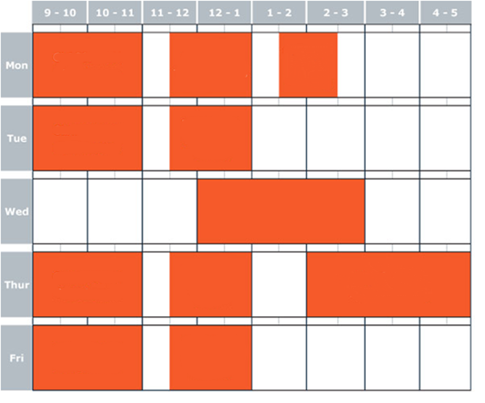
Example Timetable
CLASSROOM work to include:
12 hours of BTEC Lessons
Online GCSE Maths lessons
Online GCSE English Lessons
Tutorial

Slide 11
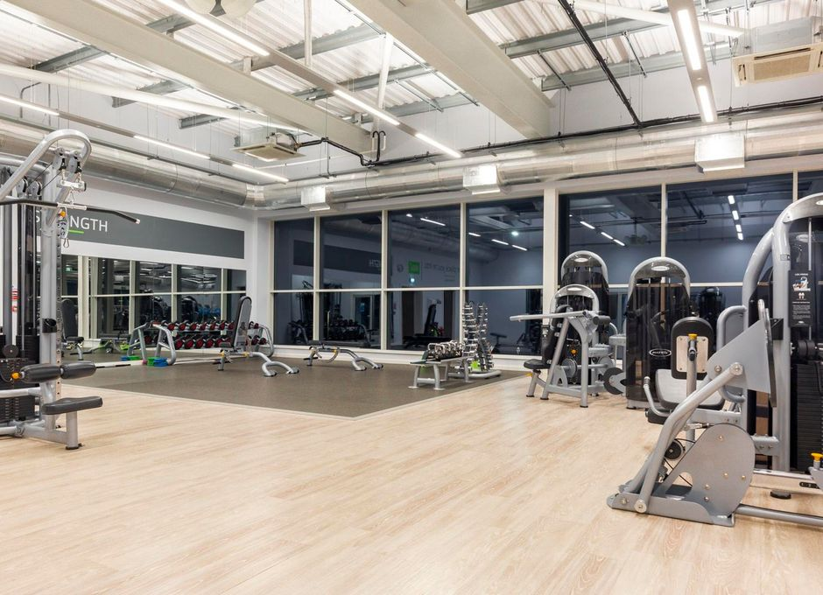
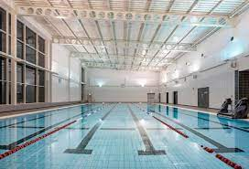
The Performance Experience
Integrated coaching/playing programme
Coaching sessions provided by UEFA qualified coaches
Designed to follow best practice - rest days, technical training, tactical training
Competitive fixture programme against other clubs in the appropriate leagues
Classroom and enrichment at Graves Health & Sports Centre and Matches at St George Graves

Slide 12
Who are VLUK?
The programme is managed by VLUK - Who Are VLUK?
https://www.youtube.com/watch?v=LiWQbf9EOCo - COO Dominic Anderson

Slide 13
Quality Assurance
VLUK is an Independent Training provider, directly funded by the UK Government, through the ESFA.
As such, VLUK is subject to the same Ofsted inspection cycle as other Schools and Colleges
Members of the VLUK Senior and Middle Leadership carry out a rigorous quality processes to ensure compliance and best educational practice.
Enrichment sessions are delivered by fully qualified coaches

Slide 14
Ofsted - Significant Progress
VLUK were awarded the top grades of ‘significant progress’ in all three themes of the Ofsted New Provider framework in November 2021.
First Nationwide 16-19 independent learning provider of education programmes to achieve this judgement in all three themes.
Quotes from Ofsted report;
‘VLUK have meticulously designed the curriculum so that learners swiftly develop the skills, knowledge and professional behaviours they need for higher education and employment’
‘Appropriately qualified and experienced staff provide high-quality teaching’
‘The highly experienced and qualified designated safeguarding leads have developed a robust culture of safeguarding’

Slide 15
Who should apply?
Young people with a strong interest in coaching sport
Young people with a strong interest in playing sport
Young people predicted 5 GCSE’s grade 4 or above including English & Maths (level 3 programmes)
Young people between 16-18 years of age
Young people with a desire and passion to play sport to their highest possible level.
Young people who would like a career in sport
Young people committed to continuing their sport and academic/vocational education
There are no financial charges for attending this course

Slide 16
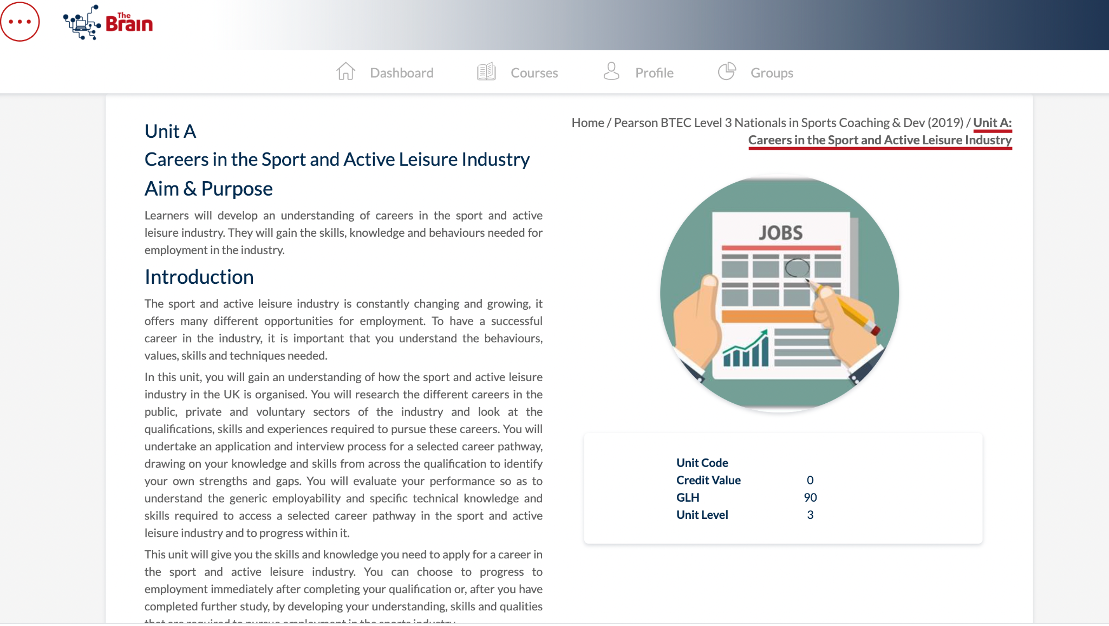
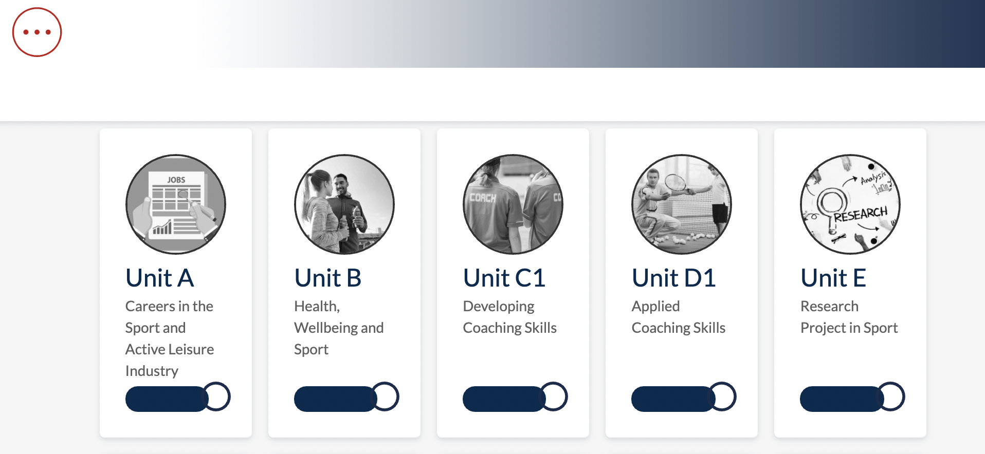
The Brain - Online Learning
‘The Brain’ - Online Learning Cloud
www.vesystems.org
Receive a personal log in
Content delivered by a tutor
Complete tasks and assessments directly through the platform.

Slide 17
Additional Support & Progression
Bursary applications supported by VLUK. (Please note bursaries cannot be guaranteed, they are intended to be a contribution towards costs, not to cover all costs associated with attending the course.)
University applications - information about the UCAS journey and support with personal statements provided through the VLUK e-learning platform and The Quadrant.
Other IAG (Information Advice & Guidance)
Dedicated safeguarding team to support learner wellbeing.

Slide 18
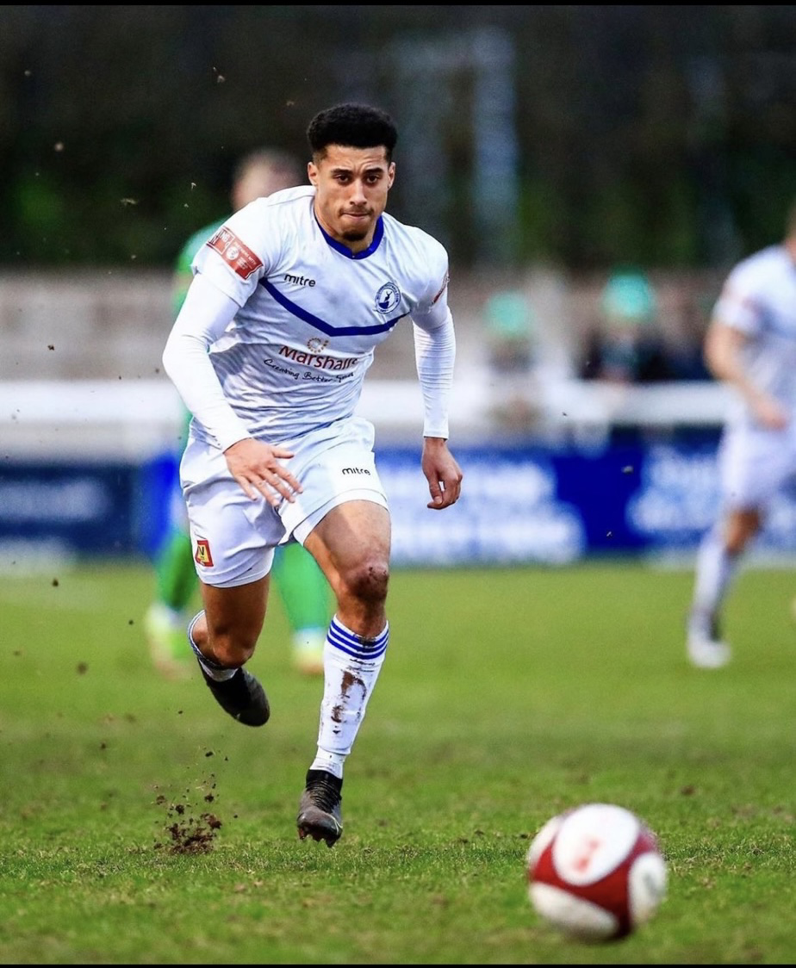
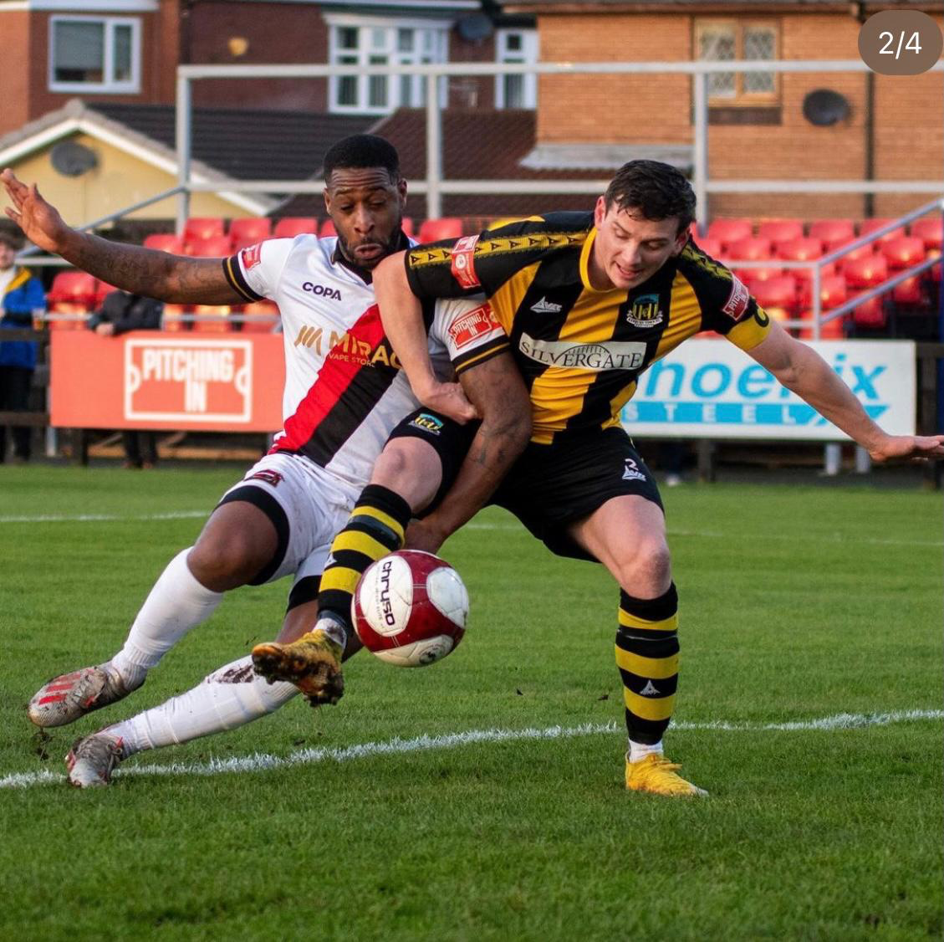
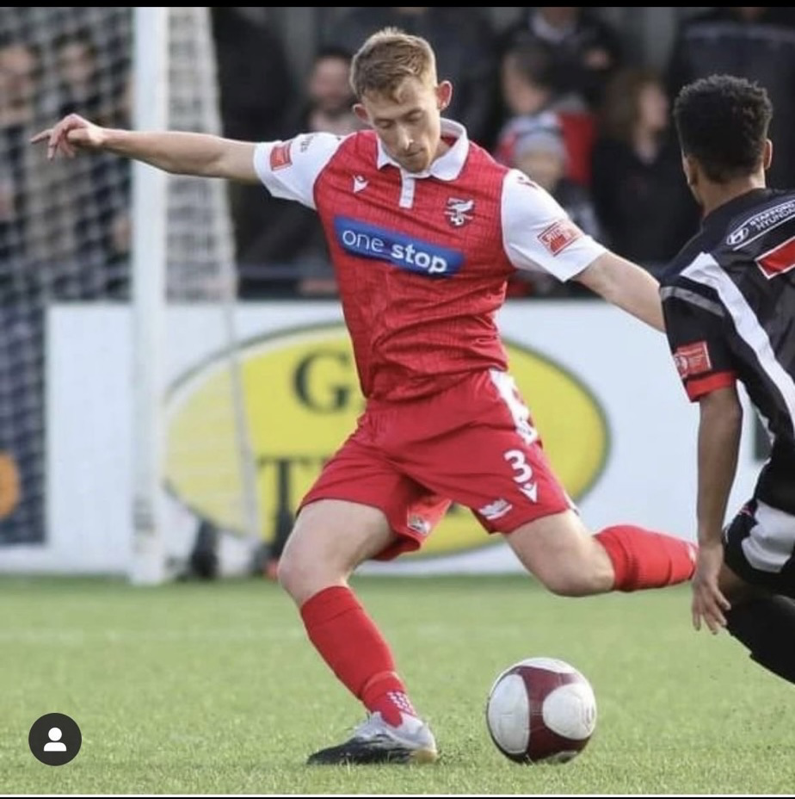
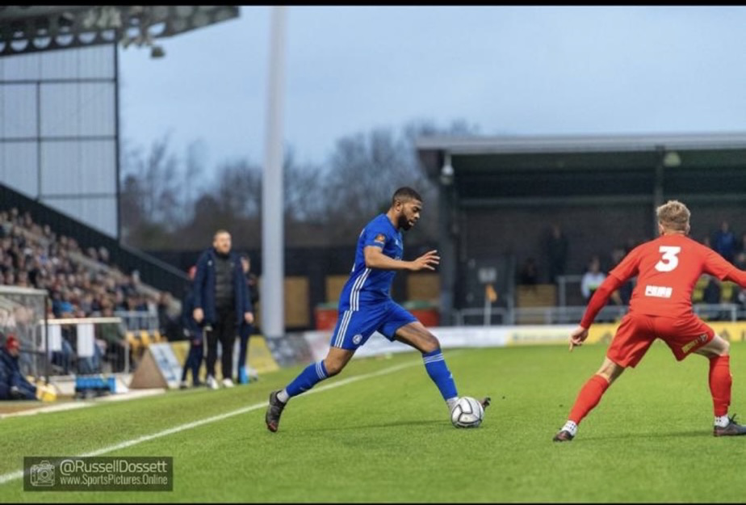
Alumni
Warren Clarke – Buxton FC. Qualitas Coach
Keenan Ferguson – Boston United. Qualitas Coach
Nathan Modest – Sheffield FC. Qualitas Community Manager
Ashley Jackson – Scarborough Athletic. Qualitas Senior Manager

Slide 19
Why Qualitas Sport Academy?
UEFA qualified coaches, worked/played in a academy and professional football environment.
Category 2 & 3 academy football modules and IDP’s.
Access to coaching qualifications.
ENRICHMENT, LEADERSHIP and EMPLOYMENT opportunities.
Clear pathways – Non league/America. Higher Education. Full time employment.

Slide 20
What happens next?
https://www.sheffieldprogress.co.uk/courses/detail/sport-football-and-education-diploma-level-3-94056

